Slide 1
Introduction
Patterson and Hennessy (1.1 thru 1.5)

Slide 2
Outline
The post PC Era
Eight great ideas
Abstractions of the computer
Moore’s law and chips

Slide 3
The Computer Revolution
Progress in computer technology
Underpinned by Moore’s Law
Makes novel applications feasible
Computers in automobiles
Cell phones
Human genome project
World Wide Web
Search Engines
Computers are pervasive

Slide 4
Classes of Computers
Personal computers
General purpose, variety of software
Subject to cost/performance tradeoff
Server computers
Network based
High capacity, performance, reliability
Range from small servers to building sized

Slide 5
Classes of Computers
Supercomputers
High-end scientific and engineering calculations
Highest capability but represent a small fraction of the overall computer market
Embedded computers
Hidden as components of systems
Stringent power/performance/cost constraints

Slide 6
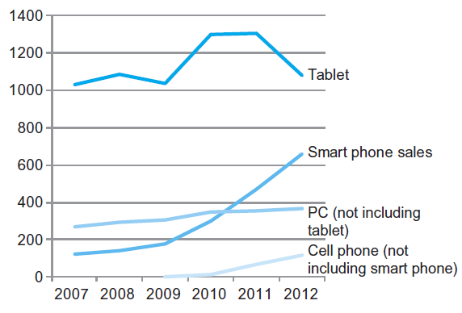
The PostPC Era

Slide 7
The PostPC Era
Personal Mobile Device (PMD)
Battery operated
Connects to the Internet
Hundreds of dollars
Smart phones, tablets, electronic glasses
Cloud computing
Warehouse Scale Computers (WSC)
Software as a Service (SaaS)
Portion of software run on a PMD and a portion run in the Cloud
Amazon and Google

Slide 8
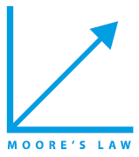







Eight Great Ideas
Design for Moore’s Law
Use abstraction to simplify design
Make the common case fast
Performance via parallelism
Performance via pipelining
Performance via prediction
Hierarchy of memories
Dependability via redundancy

Slide 9
Abstractions
The BIG Picture
Abstraction helps us deal with complexity
Hide lower-level detail
Instruction set architecture (ISA)
The hardware/software interface
Application binary interface
The ISA plus system software interface
Implementation
The details underlying and interface

Slide 10
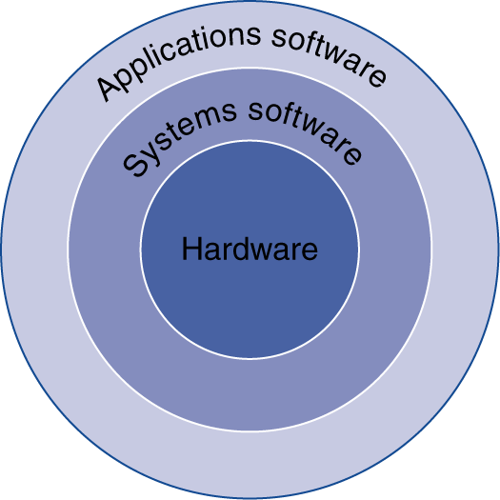
Below Your Program (Layering)
Application software
Written in high-level language
System software
Compiler: translates HLL code to machine code
Operating System: service code
Handling input/output
Managing memory and storage
Scheduling tasks & sharing resources
Hardware
Processor, memory, I/O controllers

Slide 11
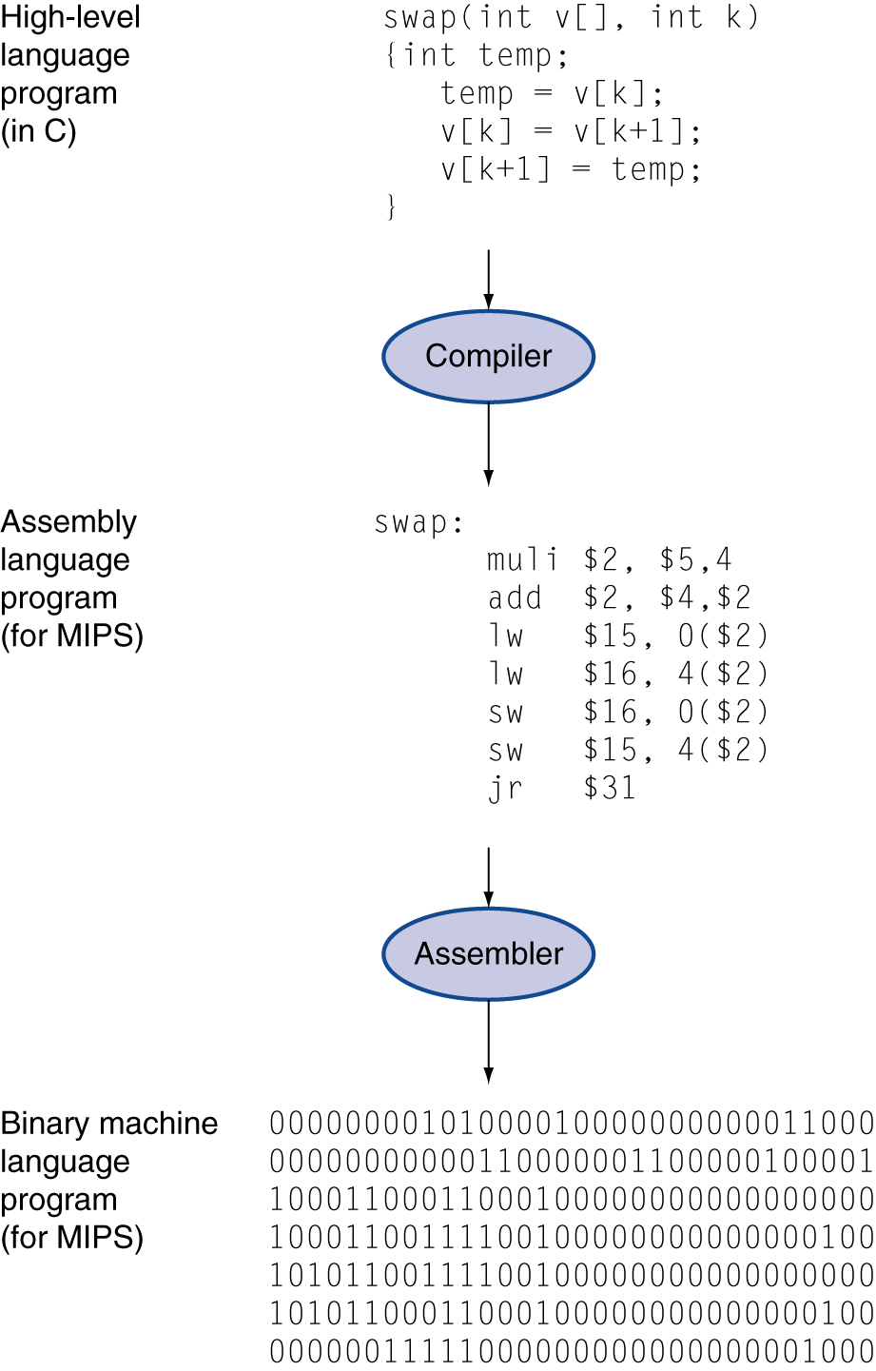
Levels of Program Code (Level)
High-level language
Level of abstraction closer to problem domain
Provides for productivity and portability
Assembly language
Textual representation of instructions
Hardware representation
Binary digits (bits)
Encoded instructions and data

Slide 12
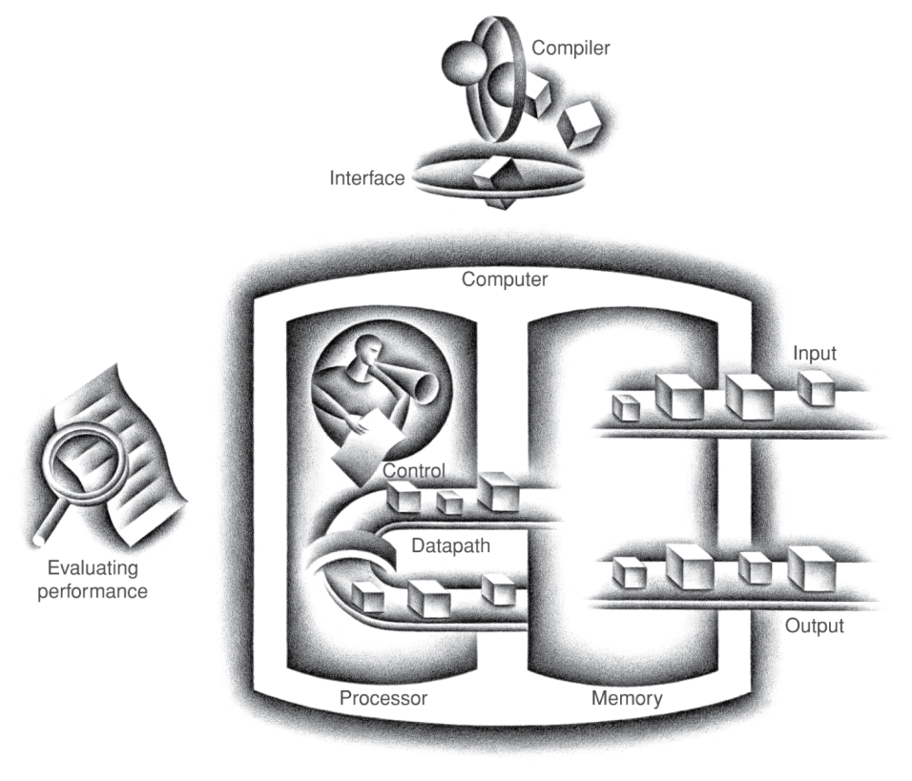
Components of a Computer (Components)
The BIG Picture
Same components for all kinds of computer
Desktop, server, embedded
Input/output includes
User-interface devices
Display, keyboard, mouse
Storage devices
Hard disk, CD/DVD, flash
Network adapters
For communicating with other computers

Slide 13
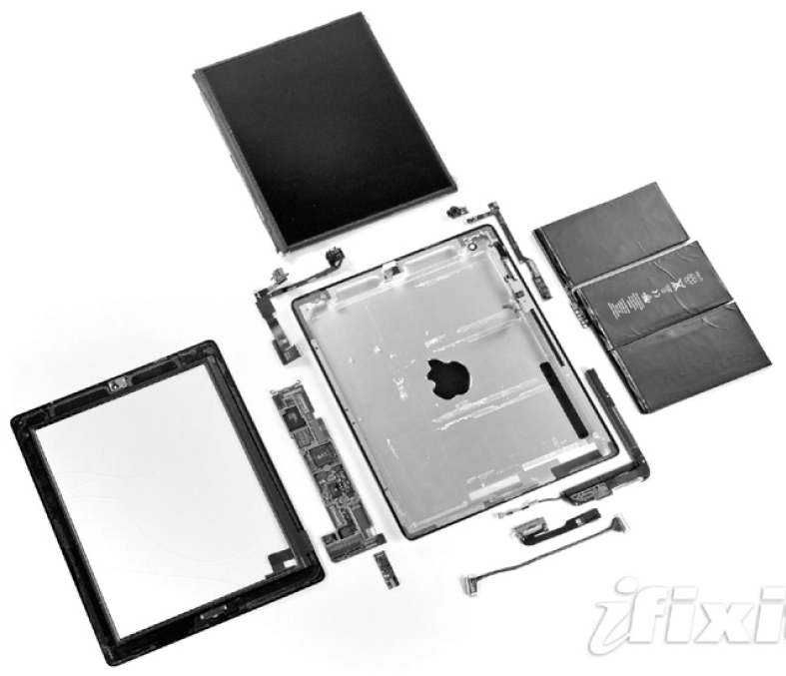
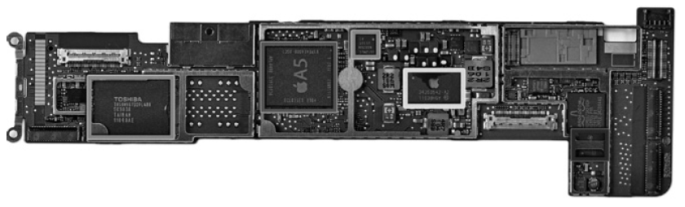
Opening the Box
Capacitive multitouch LCD screen
3.8 V, 25 Watt-hour battery
Computer board

Slide 14
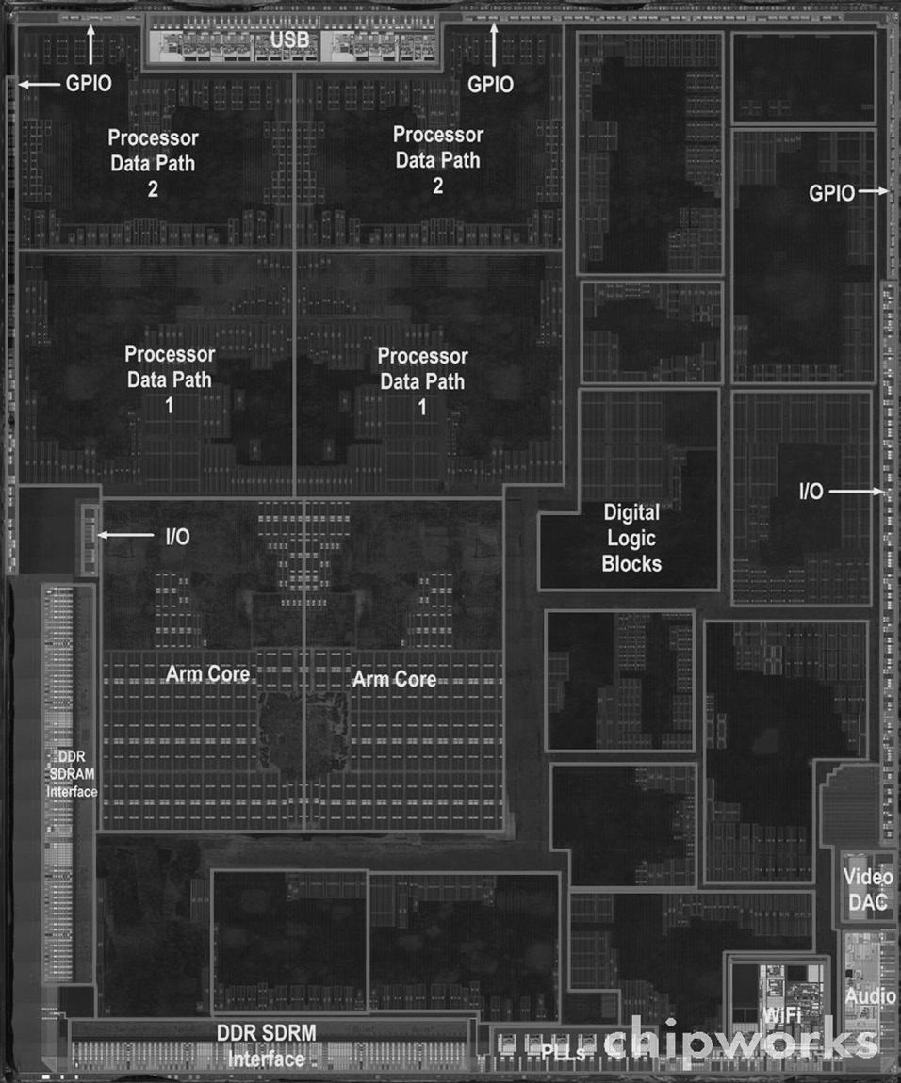
Inside the Processor (CPU)
Apple A5
Datapath: performs operations on data
Control: sequences datapath, memory, ...
Cache memory
Small fast SRAM memory for immediate access to data

Slide 15
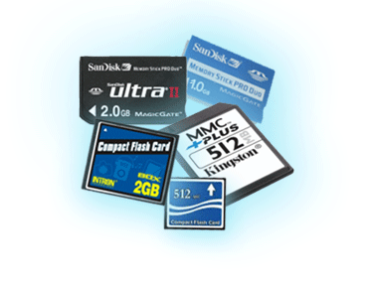
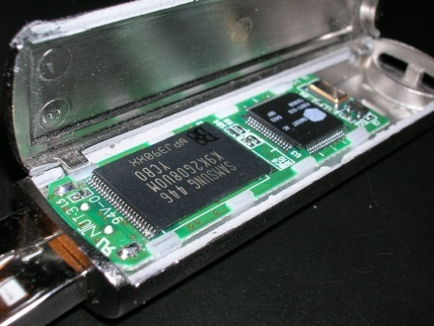
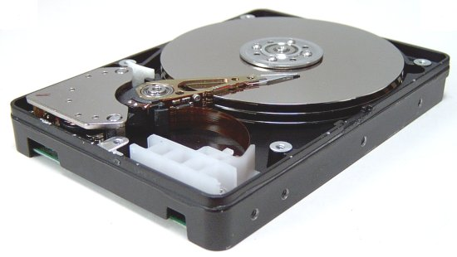
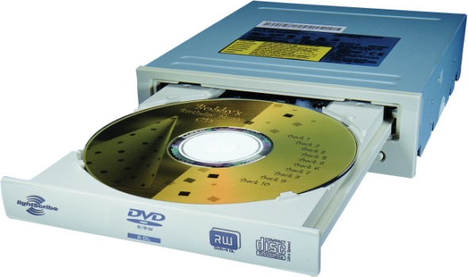
A Safe Place for Data
Volatile main memory
Loses instructions and data when power off
Non-volatile secondary memory
Magnetic disk
Flash memory
Optical disk (CDROM, DVD)

Slide 16
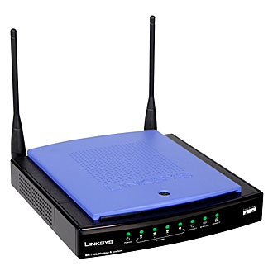
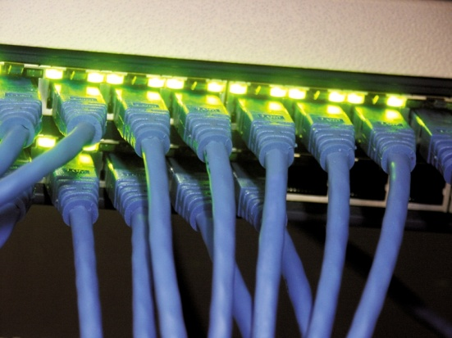
Networks
Communication, resource sharing, nonlocal access
Local area network (LAN): Ethernet
Wide area network (WAN): the Internet
Wireless network: WiFi, Bluetooth

Slide 17
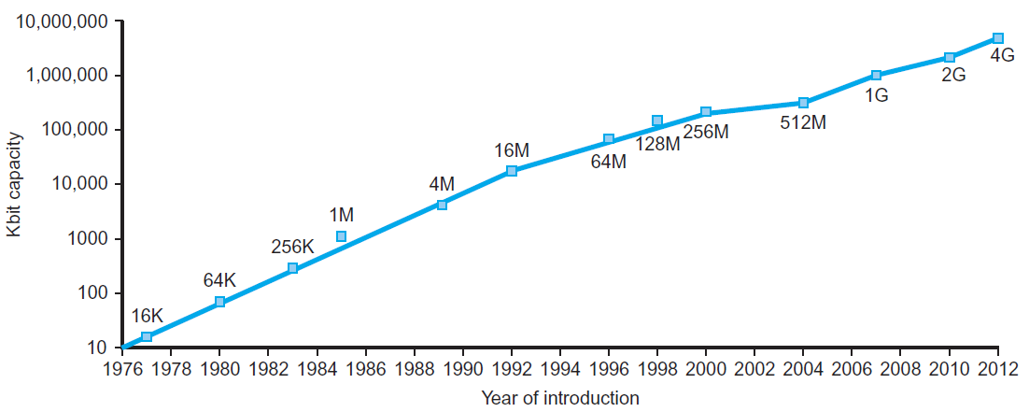
Technology Trends
Electronics technology continues to evolve
Increased capacity and performance
Reduced cost
DRAM capacity
Year | Technology | Relative performance/cost
1951 | Vacuum tube | 1
1965 | Transistor | 35
1975 | Integrated circuit (IC) | 900
1995 | Very large scale IC (VLSI) | 2,400,000
2013 | Ultra large scale IC | 250,000,000,000

Slide 18
Semiconductor Technology
Silicon: semiconductor
Add materials to transform properties:
Conductors
Insulators
Switch

Slide 19
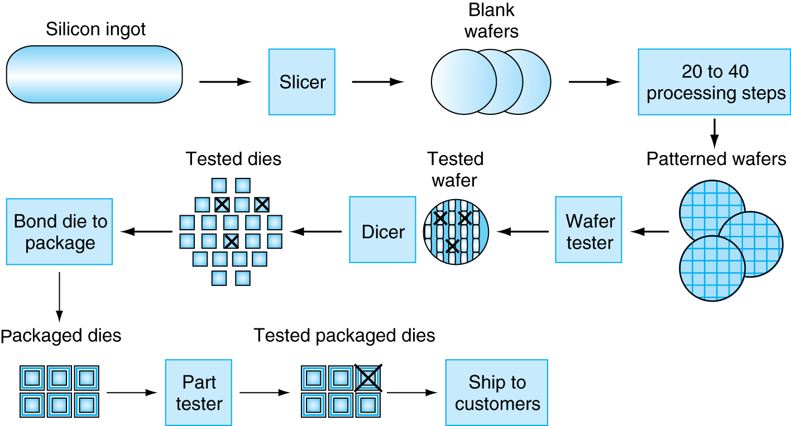
Manufacturing ICs
Yield: proportion of working dies per wafer

Slide 20
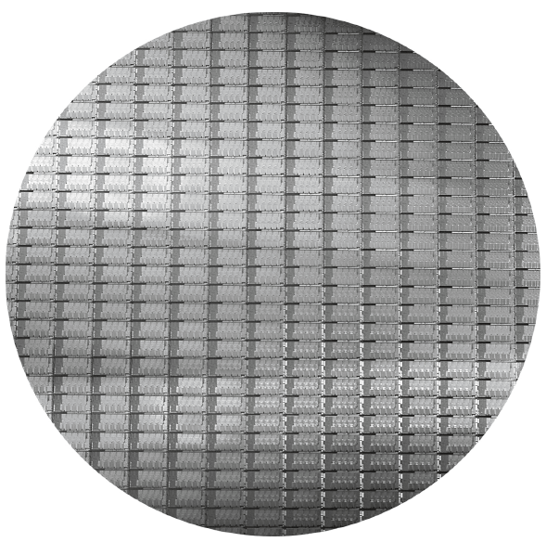
Intel Core i7 Wafer
300mm wafer, 280 chips, 32nm technology
Each chip is 20.7 x 10.5 mm

Slide 21
Integrated Circuit Cost
Nonlinear relation to area and defect rate
Wafer cost and area are fixed
Defect rate determined by manufacturing process
Die area determined by architecture and circuit design

